Slide 1
WiDS 2025 Datathon
Chang Lu

Slide 2
Introduction
The data is provided by the Healthy Brain Network (HBN), a signature scientific initiative of the Child Mind Institute, in collaboration with the Ann S. Bowers Women’s Brain Health Initiative (WBHI), Cornell University, and UC Santa Barbara.
Early identification of ADHD can lead to timely interventions.
Understanding the link between brain connectivity and behavior can aid clinical research.
Offers a practical application of machine learning to real-world neuroimaging data.

Slide 3
Objective
Goal: Build machine learning models to predict:
ADHD diagnosis (ADHD_Outcome: 0 = No/Other, 1 = ADHD)
Sex (Sex_F: 0 = Male, 1 = Female)
Based on:
Functional connectome data (brain connectivity)
Socio-demographic, emotional, and parenting information

Slide 4
Dataset Overview
Training Data (Train_New)
Subjects: 1,213 participants
Features:
Categorical Metadata: e.g., handedness, parental education
Quantitative Metadata: e.g., Age, IQ scores
Functional Connectome Matrix: 19,900+ connectivity features
Targets:
ADHD_Outcome (0 = No/Other, 1 = ADHD)
Sex_F (0 = Male, 1 = Female)

Slide 5
Dataset Overview
Test Data
304 unseen participants
Contains same features as training data, but target labels are withheld
Data Characteristics
High dimensionality (connectome)
Missing values in several metadata columns

Slide 6
Data Processing
Missing Data Handling
Quantitative: Median imputation
Categorical: Added "MISSING" category
Functional Connectome: Median imputation
Feature Engineering
Categorical Variables: One-hot encoded
Quantitative Variables: Standard scaled
Functional Connectome: Originally 19,900 features -> Reduced via PCA to 300 components
Final Structure
All preprocessing combined into a ColumnTransformer pipeline using scikit-learn

Slide 7
Modeling Selection
Models Evaluated
Preliminary Testing Sample Size: 600
Logistic Regression (baseline)
Random Forest (with SelectKBest feature selection)
XGBoost (with PCA-reduced connectome)
MLPClassifier (tuned neural network)
Cross-Validation
5-fold CV for most models (10-fold for final tuning)
ROC-AUC used as the primary evaluation metric
Modeling Pipeline
Each model wrapped in a full pipeline:
Preprocessing
Feature selection (If applicable)
Estimator

Slide 8
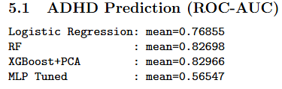
Cross-Validated AUC Scores (5-Fold CV) – ADHD
XGBoost with PCA performed the best overall.
Random Forest also performed strongly and robustly.
MLP significantly underperformed possibly due to overfitting or insufficient sample size.

Slide 9
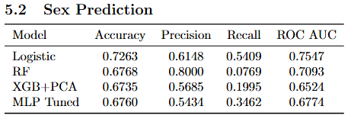
Cross-Validated AUC Scores (5-Fold CV) – Sex
Logistic Regression gave the most balanced performance.
Random Forest had high precision but very low recall.
Neural networks and XGBoost showed limited generalization on this task.

Slide 10
Final Model and Test Prediction
Best Models Selected
ADHD Prediction: XGBoost + PCA: Achieved highest AUC (0.8297) in cross-validation
Sex Prediction: Logistic Regression: Best overall balance in accuracy, precision, recall, and AUC
Final Training
Both models retrained on the full training dataset
Used full preprocessing pipeline: imputation, scaling, PCA (for functional), one-hot encoding
Test Set Prediction
Applied preprocessing and prediction pipelines to test set
Predicted: ADHD_Outcome & Sex_F

